Slide 2
Overview

Slide 3
MBRRACE-UK

Slide 4
Data for denominators and validation

Slide 5
Organisations reported

Slide 6
Types of mortality rates reported

Slide 7
Types of mortality rates reported

Slide 8
Comparator groups for Trusts & Health Boards

Slide 9
Colour coding for maps and tables

Slide 10
Organisational tables & maps

Slide 11
New report format

Slide 12
Main report overview

Slide 13
Perinatal mortality in the UK: 2018

Slide 14
Perinatal mortality in the UK: 2018

Slide 15
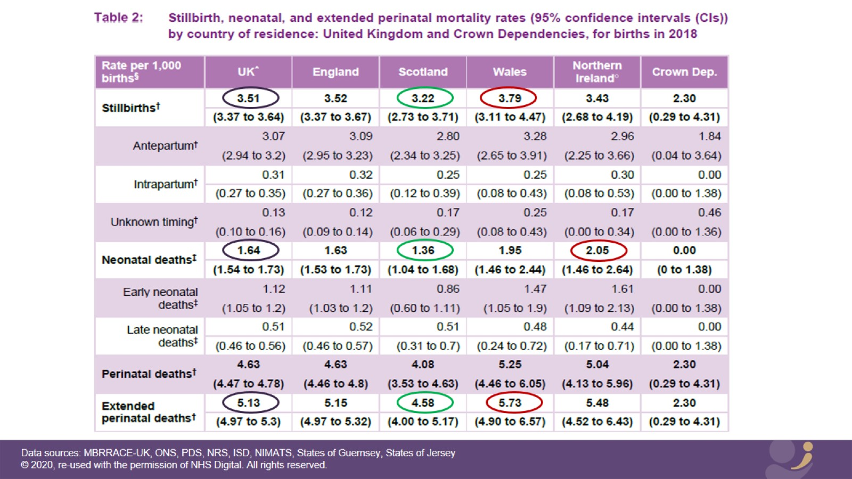

Slide 17
SB, NND and extended perinatal mortality rates for the UK and by country of residence: for births in 2018

Slide 18
Implications

Slide 19
Implications

Slide 20
Perinatal mortality in the UK: 2018

Slide 21
Mortality rates by gestational age

Slide 23
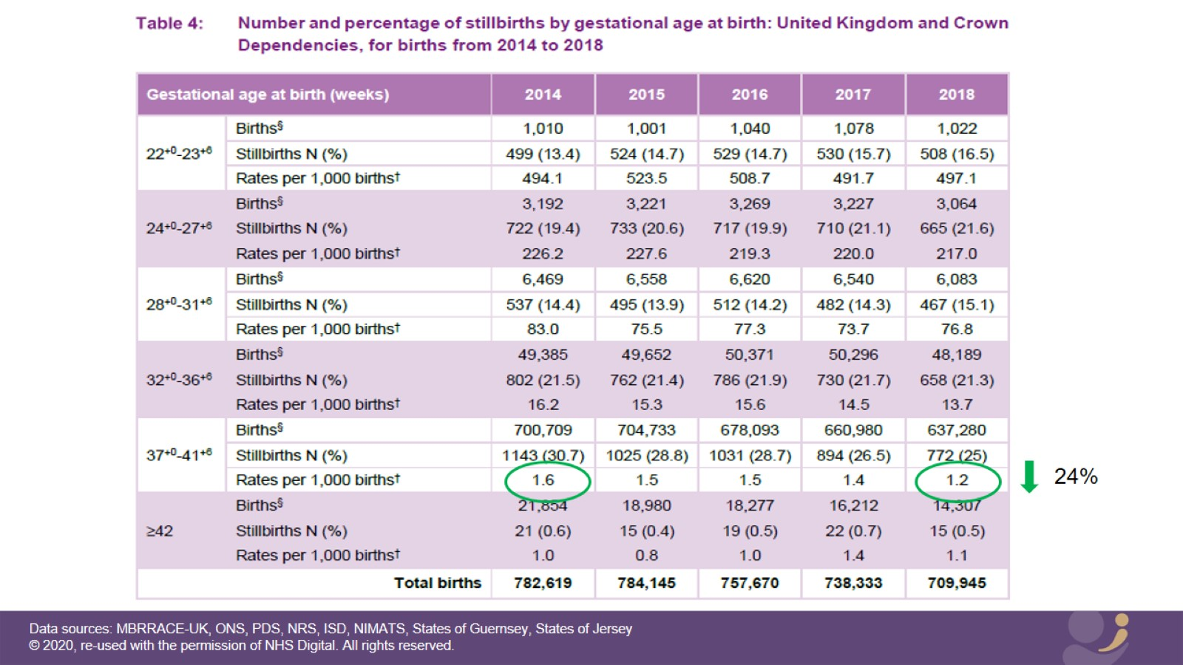

Slide 24
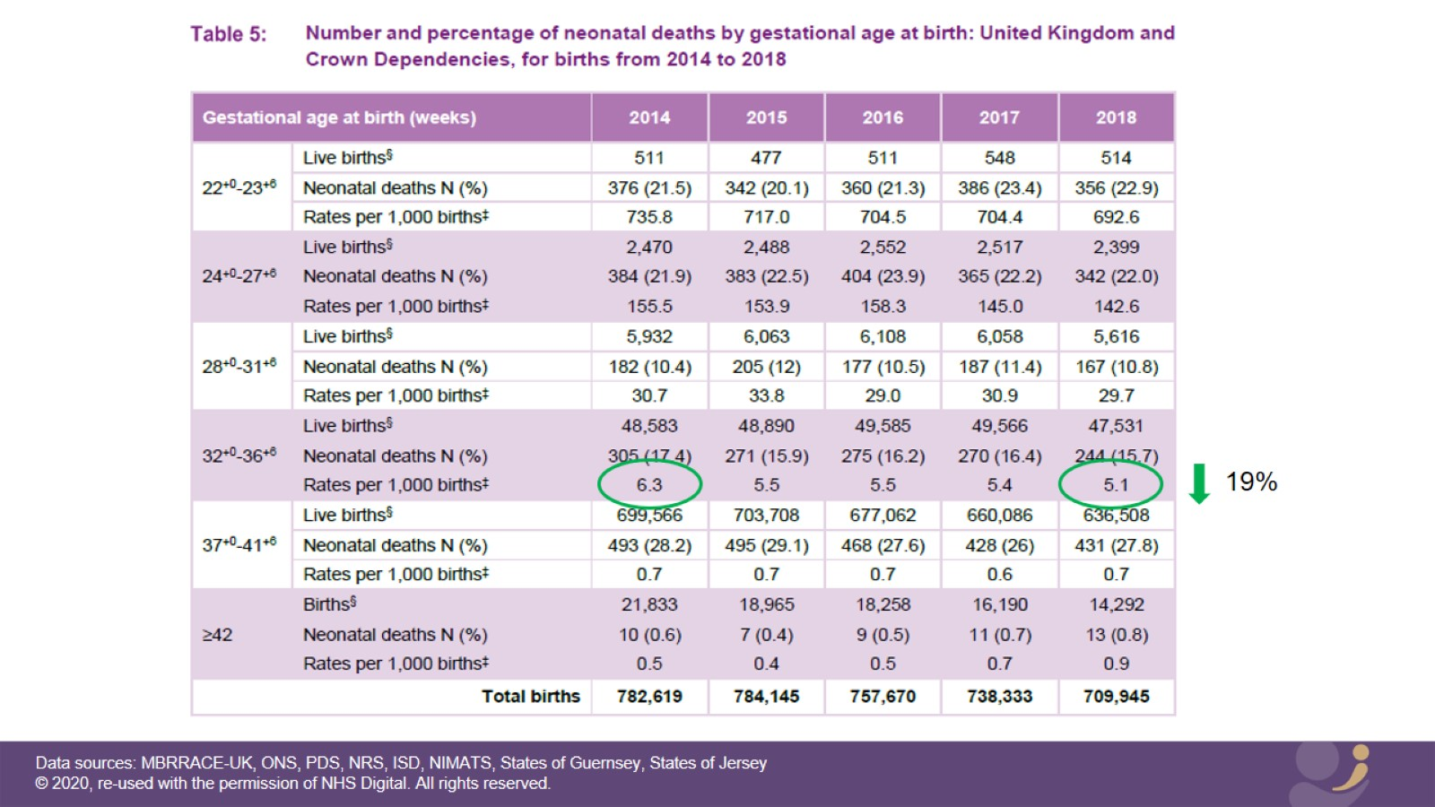

Slide 25
Implications

Slide 26
Mortality rates by gestational age

Slide 27
Effect of deprivation on perinatal mortality

Slide 28
Effect of deprivation on SB rates

Slide 29
Effect of deprivation on SBs

Slide 31
Effect of deprivation on NND rates

Slide 32
Effect of deprivation on NNDs

Slide 34
Implications

Slide 35
Effect of deprivation on perinatal mortality

Slide 36
Effect of ethnicity on perinatal mortality

Slide 37
Effect of ethnicity on SBs

Slide 39
Effect of ethnicity on perinatal mortality

Slide 40
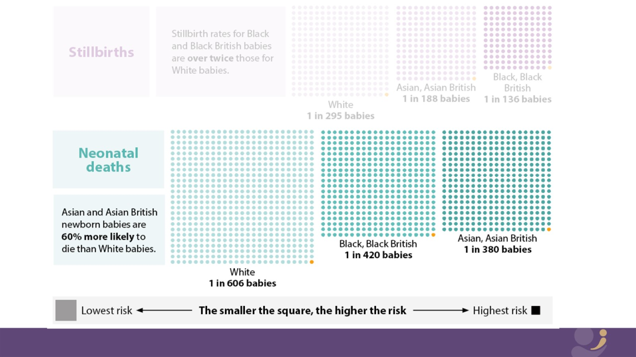

Slide 41
Implications

Slide 42
Effect of ethnicity on perinatal mortality

Slide 43
Mortality rates for Trusts and Health Boards

Slide 44
Mortality rates for Trusts and Health Boards

Slide 45
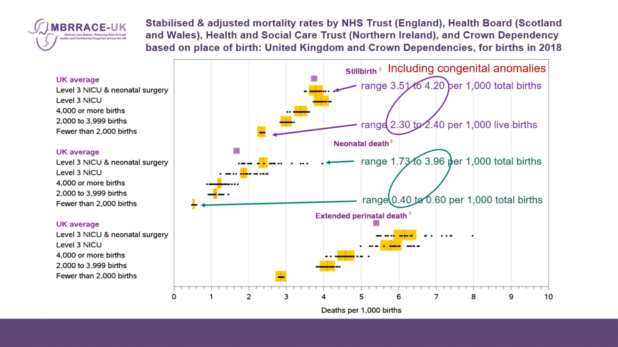
Stabilised & adjusted mortality rates by NHS Trust (England), Health Board (Scotland and Wales), Health and Social Care Trust (Northern Ireland), and Crown Dependency based on place of birth: United Kingdom and Crown Dependencies, for births in 2018

Slide 46
Mortality rates for Trusts and Health Boards

Slide 47
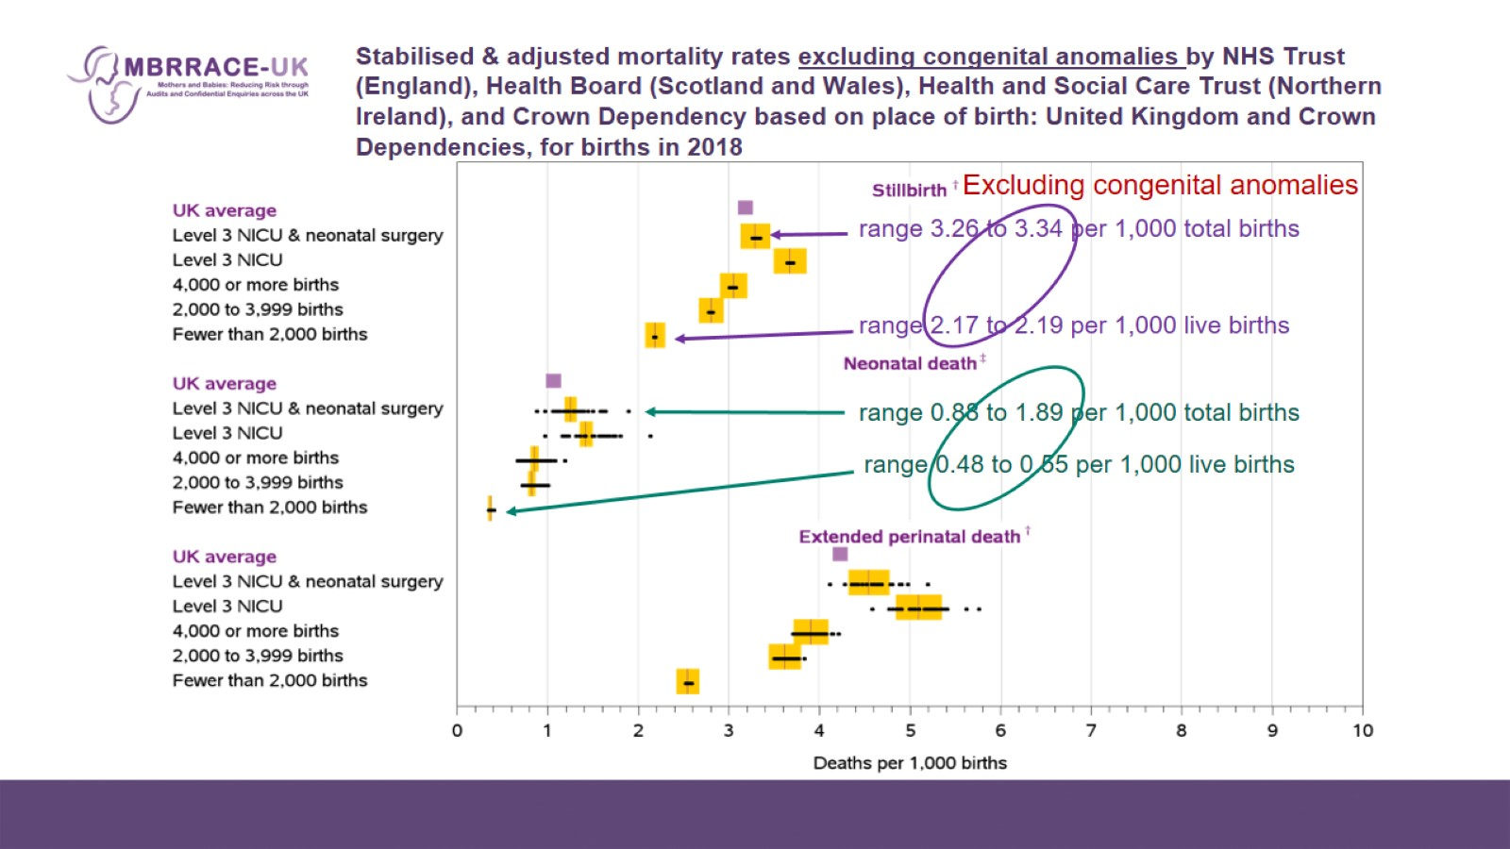
Stabilised & adjusted mortality rates excluding congenital anomalies by NHS Trust (England), Health Board (Scotland and Wales), Health and Social Care Trust (Northern Ireland), and Crown Dependency based on place of birth: United Kingdom and Crown Dependencies, for births in 2018

Slide 48
Mortality rates for Trusts and Health Boards

Slide 49
Implications

Slide 50
Mortality rates for Trusts and Health Boards

Slide 51
Mortality rates for Trusts and Health Boards

Slide 52
Offer of post-mortem examination

Slide 53
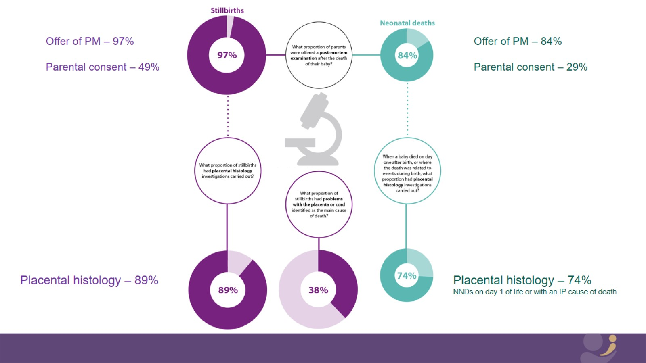

Slide 54
Offer of post-mortem examination

Slide 55
Implications

Slide 56
Implications

Slide 57
Implications

Slide 58
Implications

Slide 59
Offer of post-mortem examination

Slide 60
Thank you

Slide 61
Thank you

